Slide 1
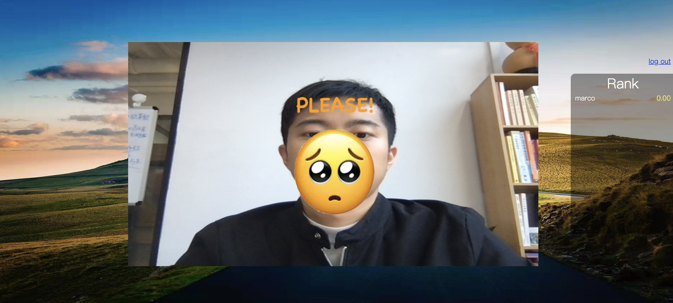
Don’t for get to exercise for 1 minute
For whom?
——— People who need to sit before computer for a long time and forget to exercise
Why?
Want to Exercise
Cost me much time
No Exercise
busy
Less is more
Only 1 minute many times a day
Foster a good habit!
How?
——— Pose net to get gestures

Slide 2
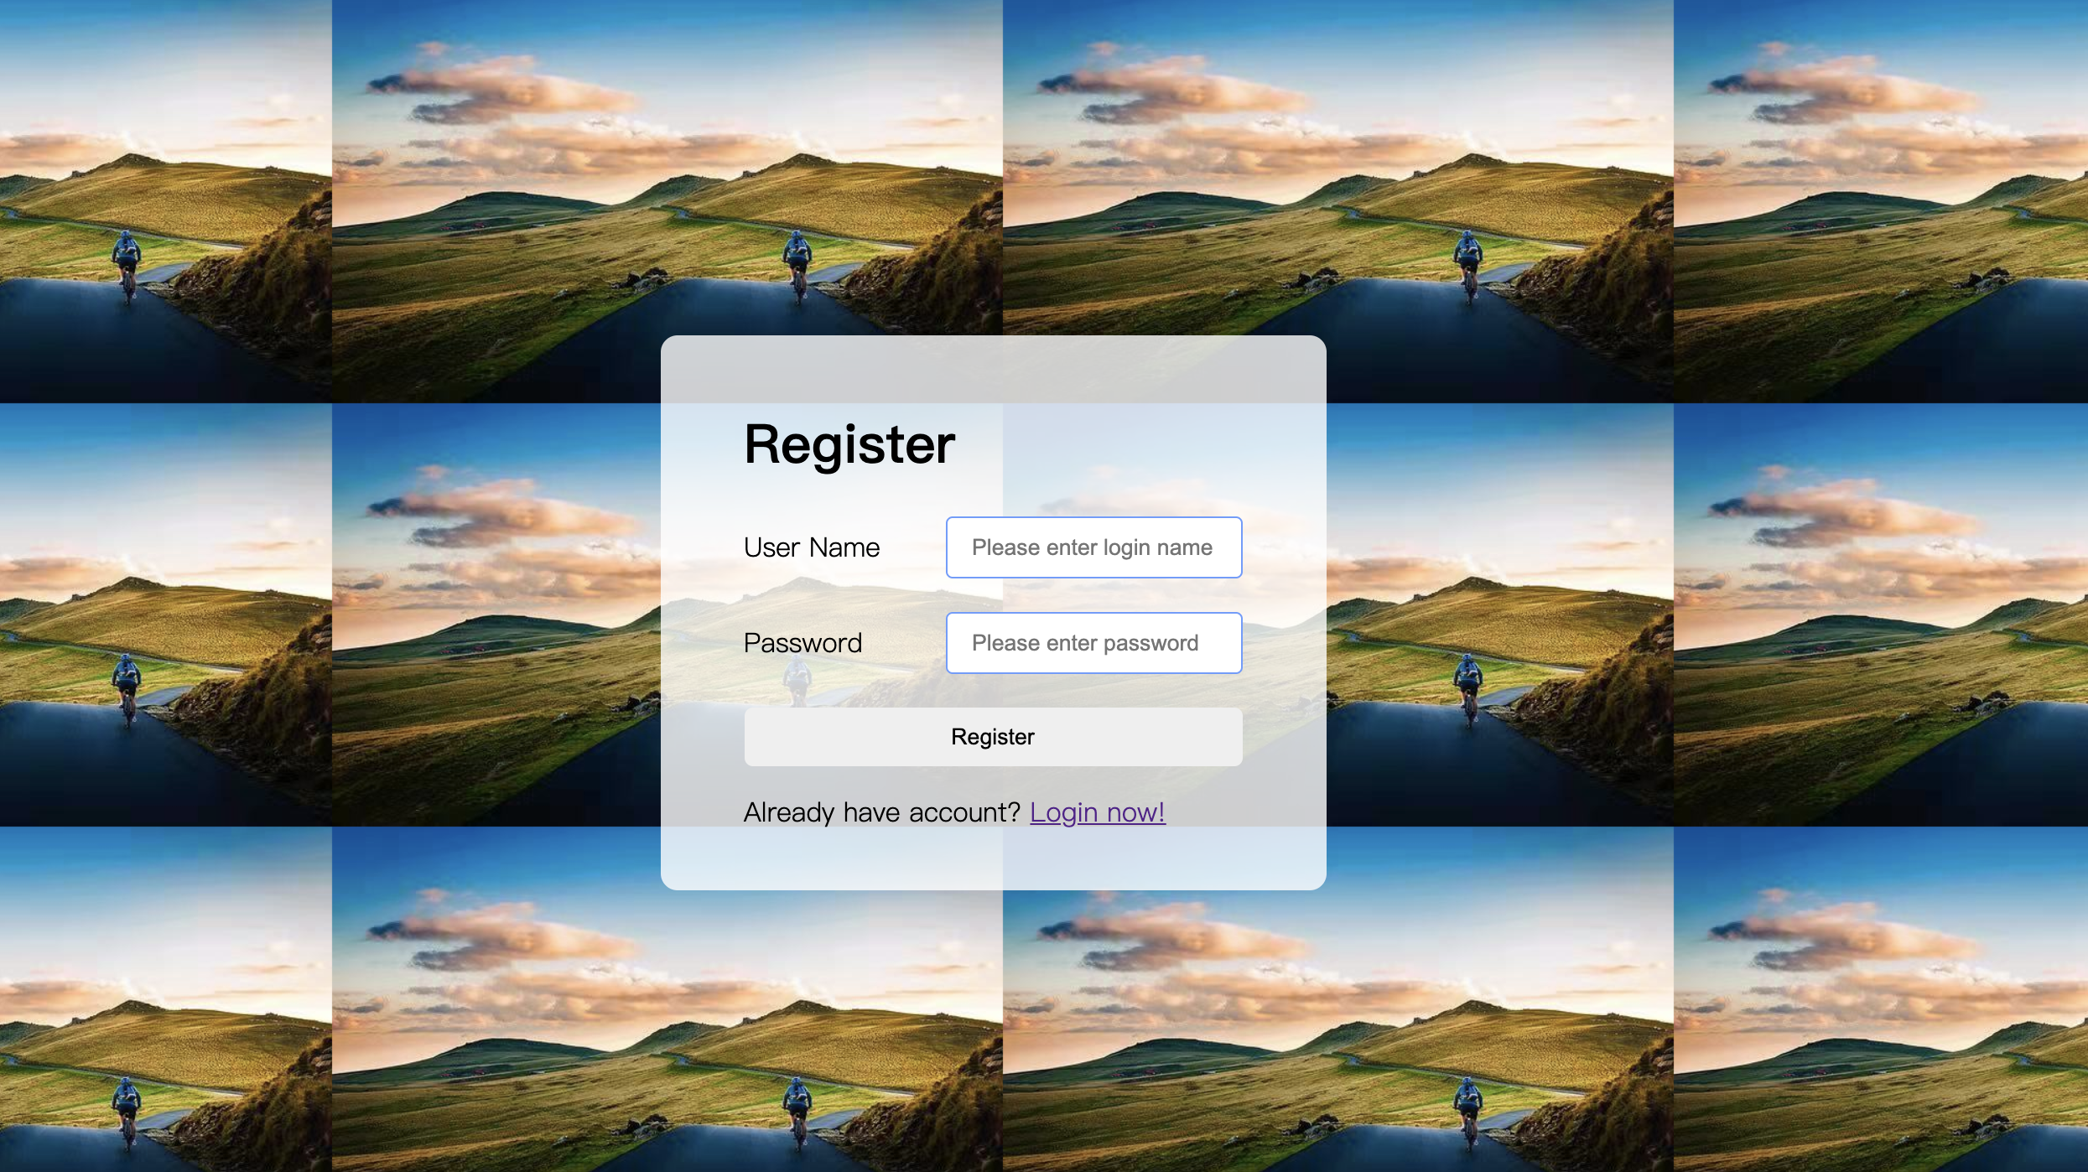

Slide 3
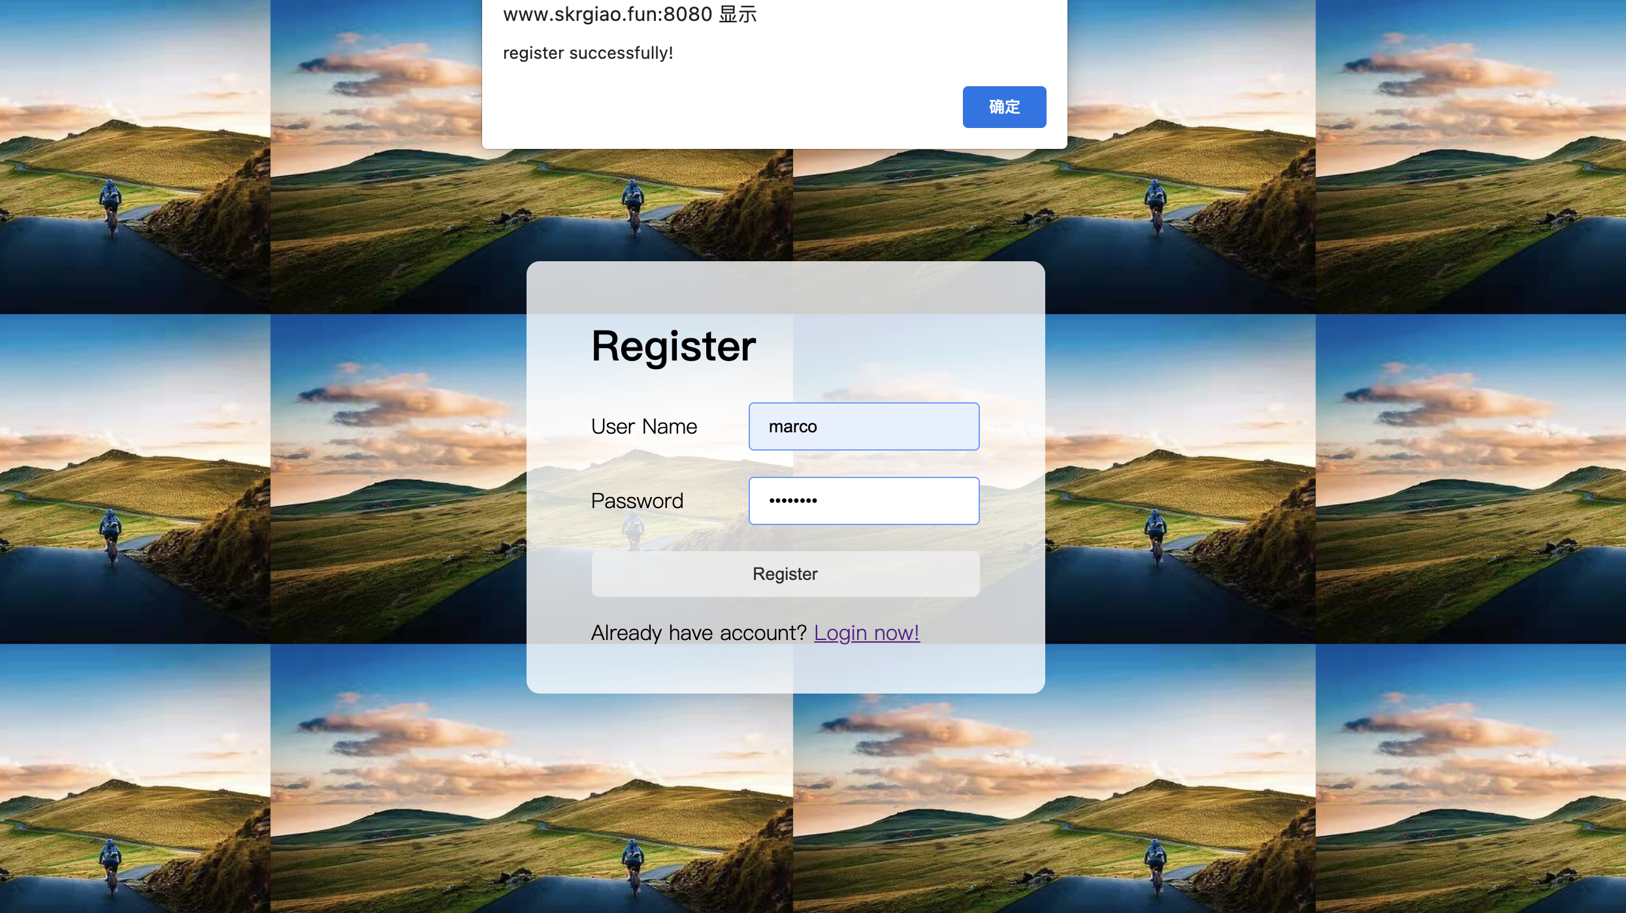

Slide 4


Slide 6
Exercise everyday
COME TO EXERCISE!
Exercise everyday
COME TO EXERCISE!

Slide 7
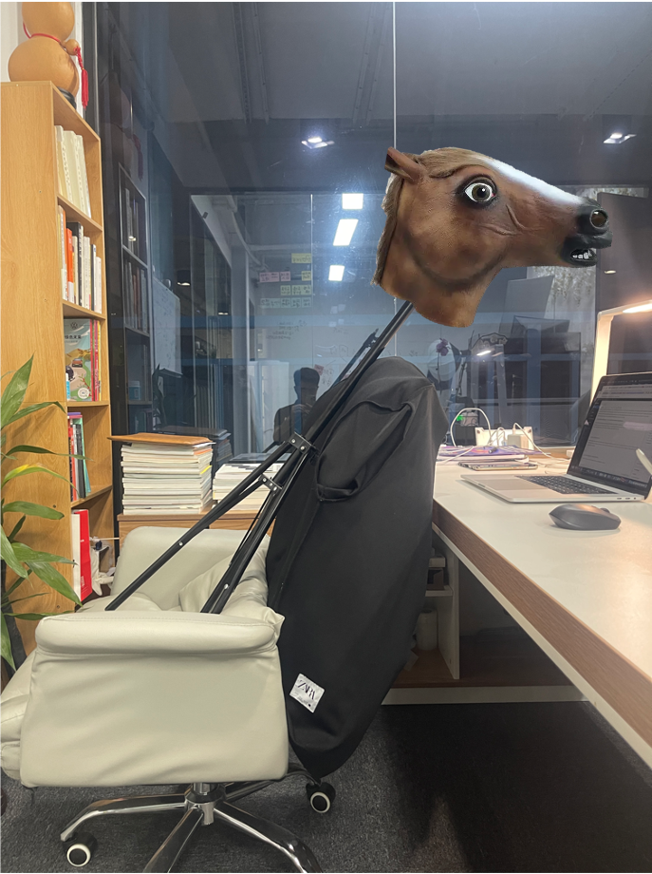
Have a new kind of automatic exercising chair!

Slide 8
Exercise everyday
COME TO EXERCISE!
These notice should happen on front-end web, but I made it happen on back-end web, it is so annoying!
Exercise everyday
COME TO EXERCISE!

Slide 9
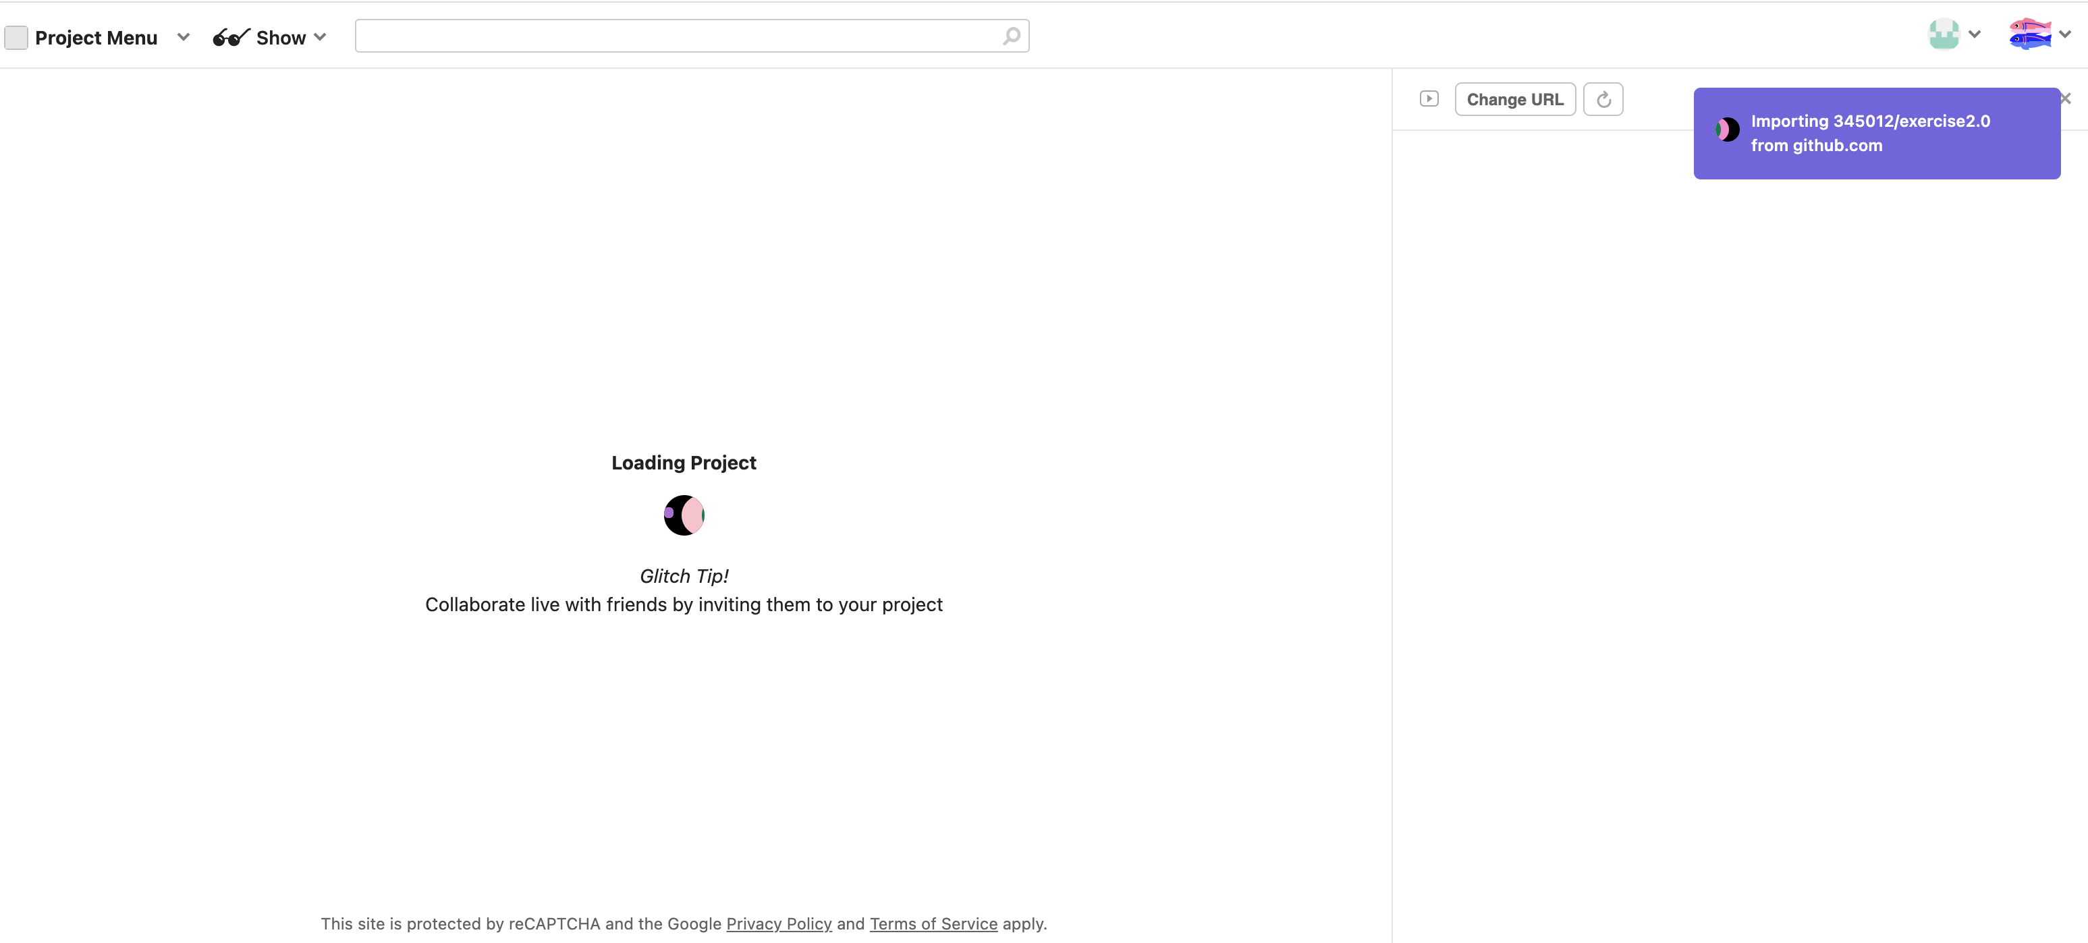

Slide 10
I have to learn how to use PM2 deploy node app on a server

Slide 11
Struggles
Link: https://github.com/345012/exercise2.0.git
1. Get familiar with establishing a database for user to register and log in
2. Get to know how to establish a real-time ranking for the game
3. Get to know how to use PM2 deploy node app on a server
4. A little confusing about notification for the desktop
Future Plans
1. Making a wonderful UI design for my game
2. Changing the game and make it more interesting for users

